Slide 1

Object Detection

Slide 2
Computer Vision with Python
Section Goals
Understand a variety of object detection methods
We will slowly build up to more complex methods as we go along.

Slide 3
Computer Vision with Python
Template Matching
Simply looking for an exact copy of an image in another image

Slide 4
Computer Vision with Python
Corner Detection
Looking for corners in images
Edge Detection
Expanding to find general edges of objects
Grid Detection
Combining both concepts to find grids in images (useful for applications)

Slide 5
Computer Vision with Python
Contour Detection
Allows us to detect foreground vs background images.
Also allows for detection of external vs internal contours (e.g. grabbing the eyes and smile from a cartoon smile face).

Slide 6
Computer Vision with Python
Feature Matching
More advanced methods of detecting matching objects in another image, even if the target image is not shown exactly the same in the image we are searching.

Slide 7
Computer Vision with Python
Watershed Algorithm
Advanced algorithm that allows us to segment images into foreground and background.
Also allows us to manually set seeds to choose segments of an image.

Slide 8
Computer Vision with Python
Facial and Eye Detection
We’ll use Haar Cascades to detect faces in images.
Note, this is not yet facial recognition, that requires deep learning which we learn in a future section.

Slide 9
Computer Vision with Python
Project Assessment
We’ll build a full computer vision application that can blur license plates automatically!

Slide 10
Template Matching

Slide 11
Computer Vision with Python
Template Matching
Template matching is the simplest form of object detection.
It simply scans a larger image for a provided template by sliding the template target image across the larger image.

Slide 12
Computer Vision with Python
Template Matching
The main option that can be adjusted is the comparison method used as the target template is slid across the larger image.
The methods are all some sort of correlation based metric.

Slide 13
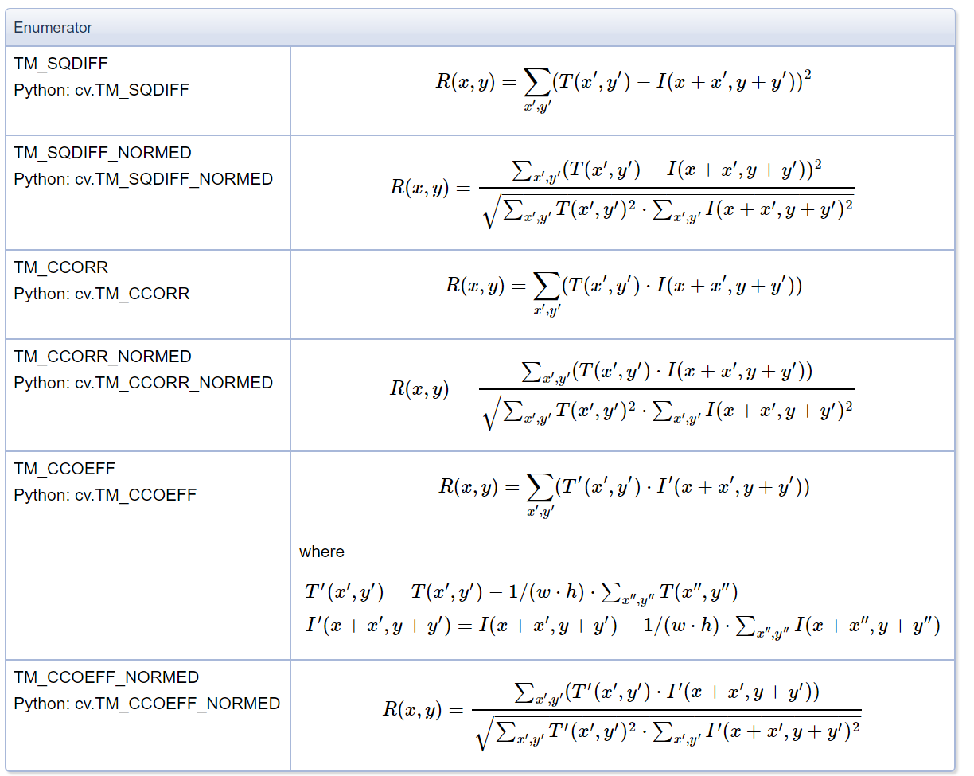
Computer Vision with Python

Slide 14
Computer Vision with Python
Let’s explore template matching with OpenCV!

Slide 15
Corner Detection

Slide 16
Computer Vision with Python
When thinking about corner detection in computer vision, we should ask ourselves:
What is a corner?
A corner is a point whose local neighborhood stands in two dominant and different edge directions.

Slide 17
Computer Vision with Python
When thinking about corner detection in computer vision, we should ask ourselves:
What is a corner?
A corner can be interpreted as the junction of two edges, where an edge is a sudden change in image brightness.

Slide 18
Computer Vision with Python
There are various corner detection algorithms.
We will take a look at some of the most popular algorithms:
Harris Corner Detection
Shi-Tomasi Corner Detection

Slide 19
Computer Vision with Python
Harris Corner Detection
Published in 1988 by Chris Harris and Mike Stephens
The basic intuition is that corners can be detected by looking for significant change in all directions

Slide 20
Computer Vision with Python
Harris Corner Detection

Slide 21
Computer Vision with Python
Harris Corner Detection

Slide 22
Computer Vision with Python
Shifting this window in any direction would result in a large change in appearance.

Slide 23
Computer Vision with Python
Flat regions will have no change in all directions.

Slide 24
Computer Vision with Python
Edges won’t have a major change along the direction of the edge

Slide 25
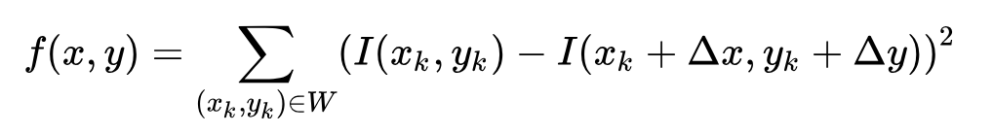
Computer Vision with Python

Slide 26
Computer Vision with Python
Shi-Tomasi Corner Detection
Published in 1994 by J. Shi and C. Tomasi in their paper Good Features to Track
It made a small modification to the Harris Corner Detector which ended up with better results.

Slide 27
Computer Vision with Python
Shi-Tomasi Corner Detection
It changes the scoring function selection criteria that Harris uses for corner detection.
Harris Corner Detector uses:
R = λ₁λ₂ - k(λ₁+ λ₂)
Shi-Tomasi uses:
R = min(λ₁,λ₂)

Slide 28
Computer Vision with Python
We will explore how to use both with the OpenCV library.
Be sure to check out the resource links (including the original publications) if you are interested in exploring the full mathematical details behind the corner detection algorithms.

Slide 29
Edge Detection

Slide 30
Computer Vision with Python
In this lecture we will learn how to use the Canny edge detector, one of the most popular edge detection algorithms.
It was developed in 1986 by John Canny and is a multi-stage algorithm.

Slide 31
Computer Vision with Python
Canny Edge Detection Process
Apply Gaussian filter to smooth the image in order to remove the noise

Slide 32
Computer Vision with Python
Canny Edge Detection Process
Find the intensity gradients of the image

Slide 33
Computer Vision with Python
Canny Edge Detection Process
Apply non-maximum suppression to get rid of spurious response to edge detection

Slide 34
Computer Vision with Python
Canny Edge Detection Process
Apply double threshold to determine potential edges

Slide 35
Computer Vision with Python
Canny Edge Detection Process
Track edge by hysteresis: Finalize the detection of edges by suppressing all the other edges that are weak and not connected to strong edges.

Slide 36
Computer Vision with Python
For high resolution images where you only want general edges, it is usually a good idea to apply a custom blur before applying the Canny Algorithm

Slide 37
Computer Vision with Python
The Canny Algorithm also requires a user to decide on low and high threshold values.
In our notebook we provide an equation for picking a good starting point for threshold values, but often you will need to adjust to your particular image.
Let’s explore this in jupyter!

Slide 38
Grid Detection

Slide 39
Computer Vision with Python
Often cameras can create a distortion in an image, such as radial distortion and tangential distortion.
A good way to account for these distortions when performing operations like object tracking is to have a recognizable pattern attached to the object being tracked.

Slide 40
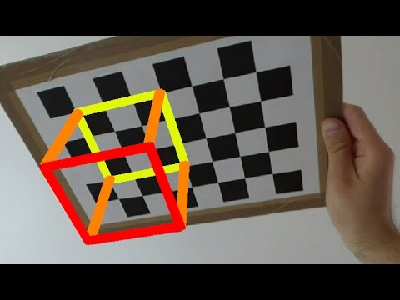
Computer Vision with Python
Grid patterns are often use to calibrate cameras and track motion.

Slide 41
Computer Vision with Python
OpenCV has built in methods for tracking grids and chessboard like patterns.
Let’s explore them!

Slide 42
Contour Detection

Slide 43
Computer Vision with Python
Contours are defined as simply a curve joining all the continuous points (along the boundary), having same color or intensity.
Contours are a useful tool for shape analysis and object detection and recognition.

Slide 44
Computer Vision with Python
OpenCV has a built in Counter finder function that can also helps us differentiate between internal and external contours.
Let’s take a look!

Slide 45
Feature Matching

Slide 46
Computer Vision with Python
Welcome to the “unofficial” halfway point of the course!
So far we’ve learned a lot of technical syntax, but haven’t really been able to apply it to more complex computer vision applications.

Slide 47
Computer Vision with Python
This is now the point in the course where we can begin to do “cool” computer vision applications.
From now on we will be using all our technical knowledge and syntax skills with OpenCV to create programs that are directly applicable to realistic situations!

Slide 48
Computer Vision with Python
We will begin by discussing Feature Matching.
We’ve already seen template matching to find objects within a larger image, but it required an exact copy of the image.
Often that isn’t useful in a real world situation!

Slide 49
Computer Vision with Python
Feature matching extracts defining key features from an input image (using ideas from corner,edge,and contour detection).
Then using a distance calculation, finds all the matches in a secondary image.
This means we are no longer required to have an exact copy of the target image!

Slide 50
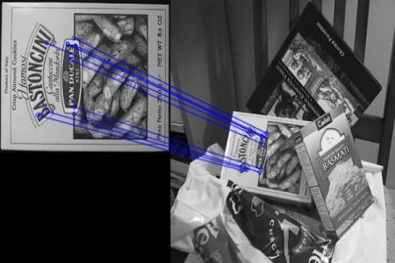
Computer Vision with Python
Feature matching results:

Slide 51
Computer Vision with Python
Notice how the input image is not exactly what is shown in the secondary image!

Slide 52
Computer Vision with Python
We will check out 3 methods:
Brute-Force Matching with ORB Descriptors
Brute-Force Matching with SIFT Descriptors and Ratio Test
FLANN based Matcher

Slide 53
Computer Vision with Python
We will be testing a generic cereal image and seeing if we can find its matching box in the cereal aisle.
Let’s get started!

Slide 54
Watershed Algorithm

Slide 55
Computer Vision with Python
In geography, a watershed is a land area that channels rainfall and snowmelt to creeks, streams, and rivers, and eventually to outflow points such as reservoirs, bays, and the ocean.

Slide 56
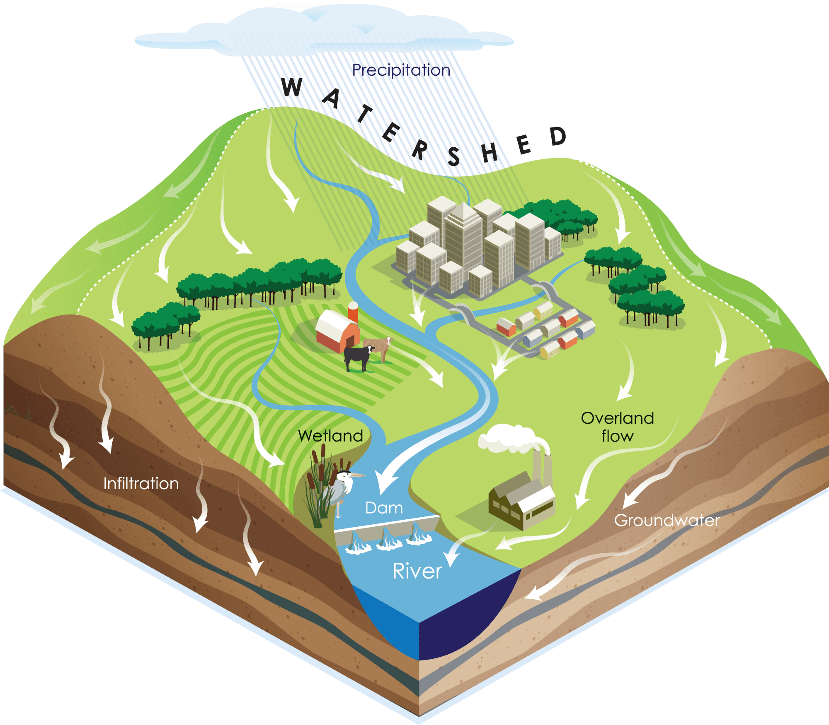
Computer Vision with Python
These watersheds can then be segmented as topographical maps with boundaries.

Slide 57
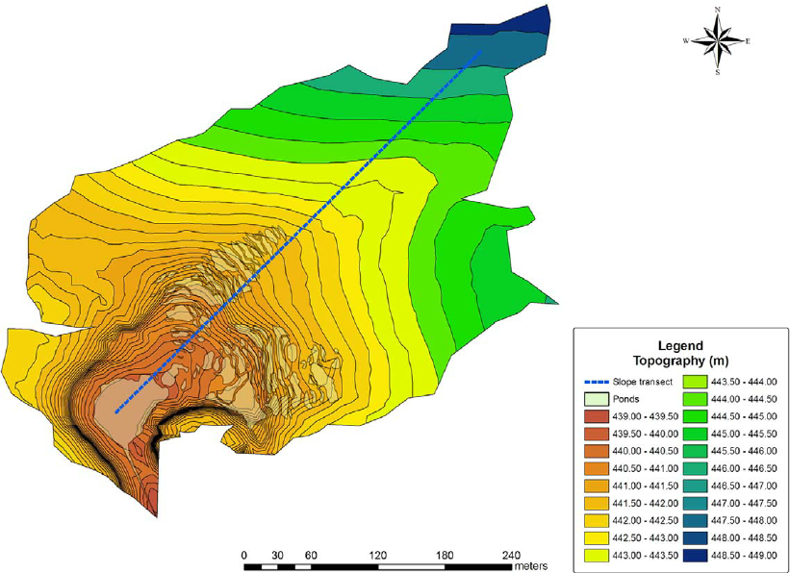
Computer Vision with Python
These watersheds can then be segmented as topographical maps with boundaries.

Slide 58
Computer Vision with Python
Metaphorically, the watershed algorithm transformation treats the image it operates upon like a topographic map, with the brightness of each point representing its height, and finds the lines that run along the tops of ridges.

Slide 59
Computer Vision with Python
Any grayscale image can be viewed as a topographic surface where high intensity denotes peaks and hills while low intensity denotes valleys.
The algorithm can then fill every isolated valleys (local minima) with different colored water (labels).

Slide 60
Computer Vision with Python
As the “water” rises, depending on the peaks (gradients) nearby, “water” from different valleys (different segments of the image), with different colors could start to merge.
To avoid this merging, the algorithm creates barriers (segment edge boundaries) in locations where “water” merges.

Slide 61
Computer Vision with Python
This algorithm is especially useful for segmenting images into background and foreground in situations that are difficult for other algorithms.
A common example is the use of coins next to each other on a table.

Slide 62
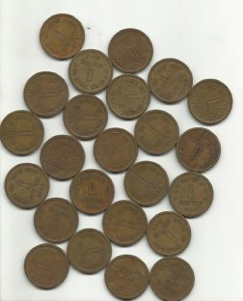
Computer Vision with Python
Attempting to segment these coins can be difficult:

Slide 63
Computer Vision with Python
It may be unclear to the algorithm if it should be treated as one large object or many small objects

Slide 64
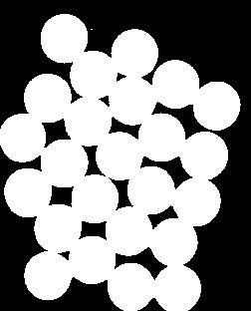
Computer Vision with Python
It may be unclear to the algorithm if it should be treated as one large object or many small objects

Slide 65
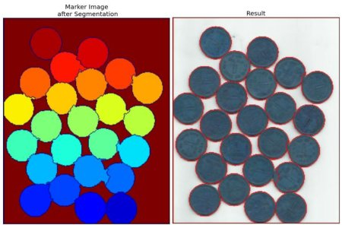
Computer Vision with Python
The watershed algorithm can be very effective for these sort of problems.

Slide 66
Computer Vision with Python
Later on we will also learn how to provide our own custom “seeds” that allow us to manually start where the valleys of the watersheds go.

Slide 67
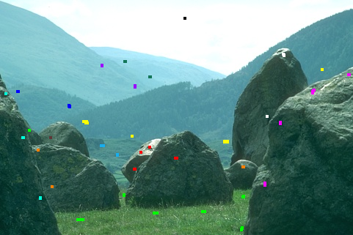
Computer Vision with Python
We will draw on our own seeds to an image:

Slide 68
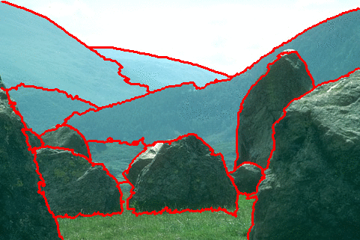
Computer Vision with Python
And then calculate the image segments.

Slide 69
Computer Vision with Python
Let’s begin by exploring the syntax of the watershed algorithm with OpenCV and then we’ll expand this idea to setting our own seeds.

Slide 70
Custom Seeds with Watershed Algorithm

Slide 71
Computer Vision with Python
Section Goals
Understand a variety of object detection methods
We will slowly build up to more complex methods

Slide 72
Face Detection
Viola-Jones Algorithm with Haar Cascades

Slide 73
Computer Vision with Python
In this lecture we will explore face detection using Haar Cascades, which is key component of the Viola-Jones object detection framework.
Keep in mind, this is face detection NOT face recognition.

Slide 74
Computer Vision with Python
We will be able to very quickly detect if a face is in an image and locate it.
However we won’t know who’s face it belongs to.
We would need a really large dataset and deep learning for facial recognition.

Slide 75
Computer Vision with Python
In 2001 Paul Viola and Michael Jones published their method of face detection based on the simple concept of a few key features.
They also came up with the idea of pre-computing an integral image to save time on calculations.

Slide 76
Computer Vision with Python
Let’s first understand the main feature types that Viola and Jones proposed.

Slide 77
Computer Vision with Python
The main feature types are:
Edge Features

Slide 78
Computer Vision with Python
The main feature types are:
Line Features

Slide 79
Computer Vision with Python
The main feature types are:
Four-rectangle Features

Slide 80
Computer Vision with Python
Each feature is a single value obtained by subtracting sum of pixels under white rectangle from sum of pixels under black rectangle.
Realistically, our images won’t be perfect edges or lines.

Slide 81
Computer Vision with Python
These features are calculated by:
mean(dark region) - mean(light region)
0 | 0 | 1 | 1
0 | 0 | 1 | 1
0 | 0 | 1 | 1
0 | 0 | 1 | 1
0 | 0.1 | 0.8 | 1
0.3 | 0.1 | 0.7 | 0.8
0.1 | 0.2 | 0.8 | 0.8
0.2 | 0.2 | 0.8 | 0.8

Slide 82
Computer Vision with Python
A perfect edge would result in a value of one.
0 | 0 | 1 | 1
0 | 0 | 1 | 1
0 | 0 | 1 | 1
0 | 0 | 1 | 1
0 | 0.1 | 0.8 | 1
0.3 | 0.1 | 0.7 | 0.8
0.1 | 0.2 | 0.8 | 0.8
0.2 | 0.2 | 0.8 | 0.8

Slide 83
Computer Vision with Python
The closer the result is to 1, the better the feature.
0 | 0 | 1 | 1
0 | 0 | 1 | 1
0 | 0 | 1 | 1
0 | 0 | 1 | 1
0 | 0.1 | 0.8 | 1
0.3 | 0.1 | 0.7 | 0.8
0.1 | 0.2 | 0.8 | 0.8
0.2 | 0.2 | 0.8 | 0.8

Slide 84
Computer Vision with Python
sum([0.8,1,0.7,0.8,0.8,0.8,0.8,0.8]) = 6.5
sum([0,0.1,0.3,0.1,0.1,0.2,0.2,0.2]) = 1.2
0 | 0 | 1 | 1
0 | 0 | 1 | 1
0 | 0 | 1 | 1
0 | 0 | 1 | 1
0 | 0.1 | 0.8 | 1
0.3 | 0.1 | 0.7 | 0.8
0.1 | 0.2 | 0.8 | 0.8
0.2 | 0.2 | 0.8 | 0.8

Slide 85
Computer Vision with Python
Mean = 6.5 / 8 = 0.8125
Mean = 1.2 / 8 = 0.15
0 | 0 | 1 | 1
0 | 0 | 1 | 1
0 | 0 | 1 | 1
0 | 0 | 1 | 1
0 | 0.1 | 0.8 | 1
0.3 | 0.1 | 0.7 | 0.8
0.1 | 0.2 | 0.8 | 0.8
0.2 | 0.2 | 0.8 | 0.8

Slide 86
Computer Vision with Python
Delta = 0.8125 - 0.15 = 0.6625
0 | 0 | 1 | 1
0 | 0 | 1 | 1
0 | 0 | 1 | 1
0 | 0 | 1 | 1
0 | 0.1 | 0.8 | 1
0.3 | 0.1 | 0.7 | 0.8
0.1 | 0.2 | 0.8 | 0.8
0.2 | 0.2 | 0.8 | 0.8

Slide 87
Computer Vision with Python
Delta = 0.8125 - 0.15 = 0.6625
0 | 0 | 1 | 1
0 | 0 | 1 | 1
0 | 0 | 1 | 1
0 | 0 | 1 | 1
0 | 0.1 | 0.8 | 1
0.3 | 0.1 | 0.7 | 0.8
0.1 | 0.2 | 0.8 | 0.8
0.2 | 0.2 | 0.8 | 0.8

Slide 88
Computer Vision with Python
Calculating these sums for the entire image would be very computationally expensive.
The Viola-Jones algorithm solves this by using the integral image.
Resulting in an O(1) running time of the algorithm.

Slide 89
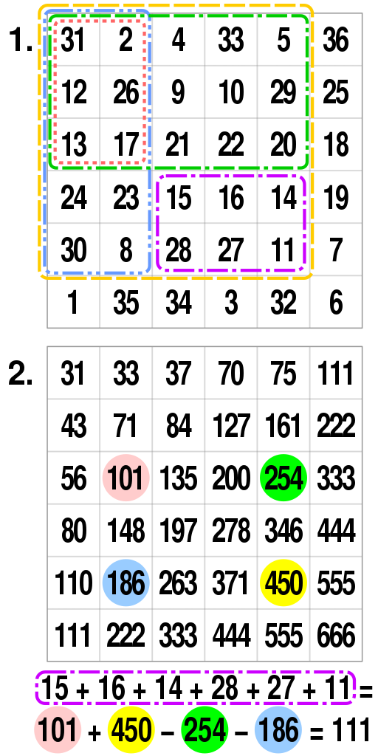
Computer Vision with Python
An integral image is also known as a summed area table.

Slide 90
Computer Vision with Python
To sum up a subrectangle of its values; each coloured spot highlights the sum inside the rectangle of that colour.

Slide 91
Computer Vision with Python
The algorithm also saves time by going through a cascade of classifiers.
This means we will treat the image to a series (a cascade) of classifiers based on the simple features shown earlier.
Once an image fails a classifier, we can stop attempting to detect a face.

Slide 92
Computer Vision with Python
A common misconception behind face detection with this algorithm is that the algorithm slowly “scans” the entire image looking for a face.
This would be very inefficient, instead we pass the cascade of classifiers.

Slide 93
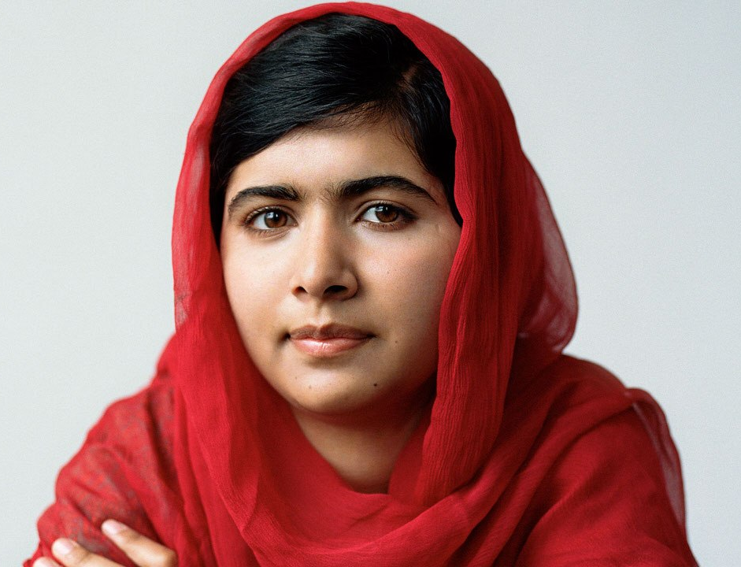
Computer Vision with Python
First we need a front facing image of a person’s face.

Slide 94
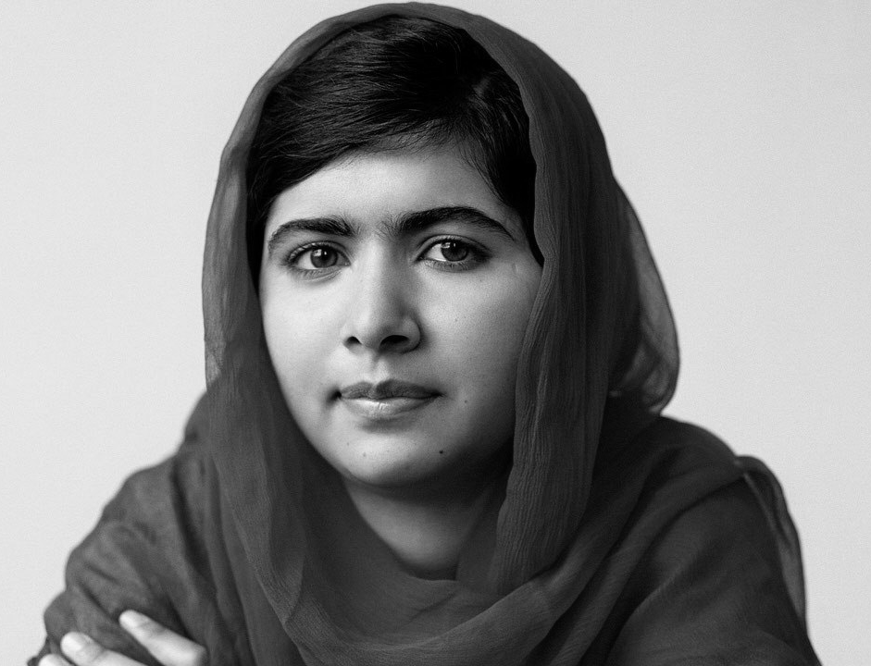
Computer Vision with Python
Then turn it to grayscale.

Slide 95
Computer Vision with Python
Then we will begin the search for Haar Cascade Features.

Slide 96
Computer Vision with Python
One of the very first features searched for is an edge feature indicating eyes and cheeks.

Slide 97
Computer Vision with Python
If the image were to fail for the search of this feature, we can quickly say there is no face.

Slide 98
Computer Vision with Python
If it passed, then we search for the next feature, such as the bridge of the nose.

Slide 99
Computer Vision with Python
We continue through this cascade (which can be thousands of features).

Slide 100
Computer Vision with Python
Until the algorithm detects the face.

Slide 101
Computer Vision with Python
Theoretically this approach can be used for a variety of objects or detections.

Slide 102
Computer Vision with Python
For example we’ll also work with a pre-trained eye detector.

Slide 103
Computer Vision with Python
The downside to this algorithm is the very large data sets needed to create your own features.
However, luckily many pre-trained sets of features already exist.

Slide 104
Computer Vision with Python
OpenCV comes with pre-trained xml files of various Haar Cascades.
Later on in the deep learning section of the course, we will see how to create our own classification algorithms for any distinct group of images (e.g. cats vs dogs)

Slide 105
Computer Vision with Python
We’ve placed pre-trained .xml files in the DATA folder.
We will also be using a pre-trained file for your upcoming project assessment.
But first, let’s explore how to use facial detection with OpenCV!

Slide 106
Face Detection with OpenCV

Slide 107
Detection Assessment

Slide 108
Detection Assessment
Solutions

